Slide 1
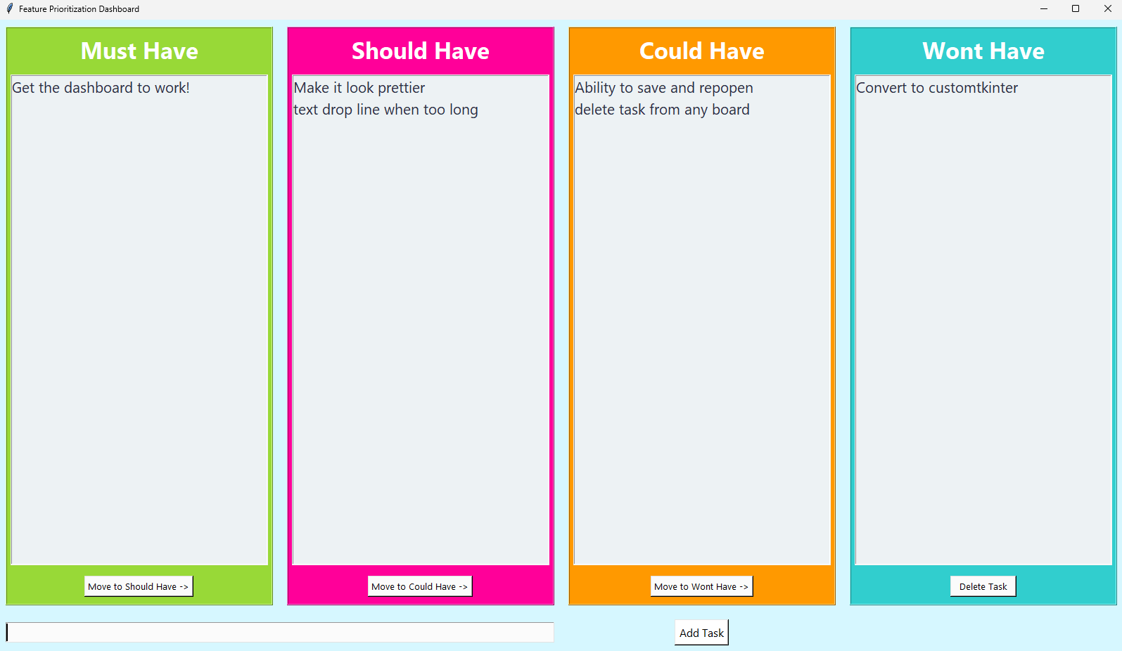
Feature Prioritization Dashboard
This dashboard uses the MoSCoW prioritization method, allowing users to add tasks to lists, move tasks between them, and delete tasks to help effectively prioritize features!
Damian A. Senquiz
GitHub Repository

